Slide 1
LEADERSHIP IN HEALTH CARE: NURSES AND MIDWIVES AS AGENTS OF CHANGE
PRESENTED AT THE INDUCTION WORKSHOP OF THE NATIONAL ASSOCIATION OF NIGERIA NURSES AND MIDWIVES ON 14TH DECEMBER, 2015
BY PROFESSOR MILDRED JOHN, DEPARTMENT OF NURSING SCIENCE, UNIVERSITY OF CALABAR

Slide 2
Protocols
Outline of presentation
Introduction
The health care delivery system in Nigeria and leadership in health care
Nurses and midwives as agents of change
Challenges to being agents of change
The way forward

Slide 3
INTRODUCTION
The health care industry globally is continually transforming into a care delivery model that is more efficient, less costly, and more outcomes-oriented
But despite technological and information advancement several issues create challenges which not only make today's healthcare landscape very dynamic and complex but have also weakened the system in many third world countries
These issues include changing global disease patterns and trends, unsustainable healthcare reforms and imperatives, and health personnel shortages

Slide 4
Even health care consumers are also transforming: They
Are more knowledgeable and expect to engage properly to manage their health issues
Desire the highest quality care at lower cost
Expect better health outcomes and prefer to pay for these outcomes rather than for mere activities
When not satisfied they not only criticize but tend to lose faith in the system
To regain public trust, the health care system must initiate some changes and adapt them to the needs of patients. Nurses and midwives are critical change agents in this care transformation agenda.

Slide 5
According to Dr. Chan (Secretary-General of WHO] “the nursing profession can transform the way health services are organized and how health care is delivered”
As frontline care staff closest to patients nurses and midwives are in the best position to initiate change and resolve care issues that arise by:
Identifying problems
Determining effective ways of solving them to improve the value of care,
Creating and implementing change,
Coordinating the change
Effectively leading patients to engage in care

Slide 6
The landscape of nursing is also changing globally because of:
Technological advancement
Advanced communication and information technology
Nursing shortages (especially of educators) resulting in unsafe nurse: patient ratios in relation to patient acuity
Task shifting in the health care system
Expanded scope of nursing practice and yet not practising at the full scope of practice

Slide 7
Health Reimbursement policy and the need for nursing to market its services
Change in consumer knowledge, expectations and demands, which is changing the consumer-provider dynamics positively
Clinical governance in the health sector
Innovations in health e.g. Standardized nursing languages; application of theories and nursing models to impact care and technology-driven care
This changing landscape requires some critical paradigm shifts in nursing practice which the nurse and midwife must make

Slide 8
Because of these issues and their effect on nursing practice globally, Hester Klopper - the Immediate past President of the Honors Society of Nursing (Sigma Theta Tau International), asked the critical question “Is nursing “on the edge”, “over the edge”, or “cutting edge”?
In most developing countries, including Nigeria, nursing is either “on the edge” or “almost over the edge” because 21st-century medical technology is being delivered with 19th-century organizational structures and management practices resulting in failure of protocols to achieve quality and improve the value of care being delivered

Slide 9
ONE THE EDGE

Slide 10
OVER THE EDGE

Slide 11
Factors that may make nursing to topple over the edge in some countries include:
Critical staff shortages
Task shifting versus “task dumping”
Poor staff skill mix for patient acuity
Misinterpretation of “Professionalism” of nursing
Not practising to the full scope of practice
Scope of practice barriers

Slide 12
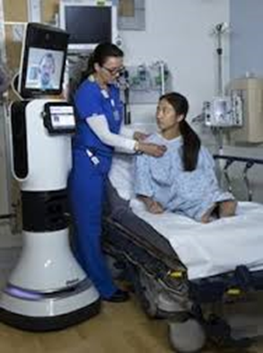
CUTTING EDGE

Slide 13
Nursing is advanced and cutting edge in the first world countries because of:
Evidence-based/best practices
Value-driven and value-added care
Ability of nurses to practise to the full extent of their education and training and removal of scope of practice barriers
Development of integrated care strategies to ensure better patient outcomes
Transformation of care at the bedside

Slide 14
Competency in nursing informatics and the use of electronic health records
Involvement of nurses in policy making
Use of innovations, advanced technologies and Technology-driven care/Virtual health e.g. use of Avatar technology in patient care, patient education and in nursing classrooms. As web-based virtual agents Avatars not only perform clerical duties but also dispense medical information and educational support materials to patients and their families

Slide 15
In Spain, an avatar named Osane has been assisting patients with matters such as booking or changing a health appointment and giving basic advice on healthy living and common illnesses
Cisco Systems Inc. has also developed an avatar named Patty that counsels hospital patients, gives information on treatment and allows them to ask questions they might be too embarrassed to ask a nurse or physician.

Slide 16
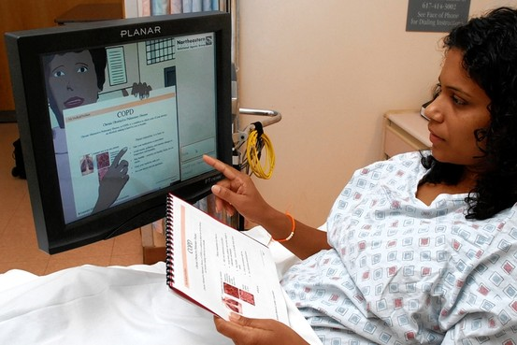

Slide 17
LEADERSHIP IN HEALTHCARE
“I have learned that people will forget what you said, people will forget what you did, but people will never forget how you make them feel” - Maya Angelou
“The first responsibility of a leader is to define reality. The last is to say thank you. In between, the leader is a servant.” - Max De Pree
“Good leaders must first become good servants” – Robert Greenleaf

Slide 18
These 3 quotes speak volumes for leaders and potential leaders in health care
As complex issues confront the health care system effective leadership becomes necessary
Such leadership should be rotational (distributive) with each professional group taking the leadership role when his/her expertise is required for decisions concerning the patient and his care
This however implies adequate leadership knowledge and skills by all healthcare professionals

Slide 19
Many leadership models are available to help nurses and midwives become effective leaders.
These models define effective leadership, describe leadership behaviour, and suggest paths of leadership development
The situation of leadership defines the model used
3 models are discussed here because they:
Facilitate change and are best suited for healthcare

Slide 20
Are concerned about integrity, creating a vision, setting direction, engaging individuals/the organization, moving forward together and
They involve leading self, leading others, leading change, and leading for results
These 3 models are:
Distributed/distributive leadership
Transformational leadership
Servant-leadership

Slide 21
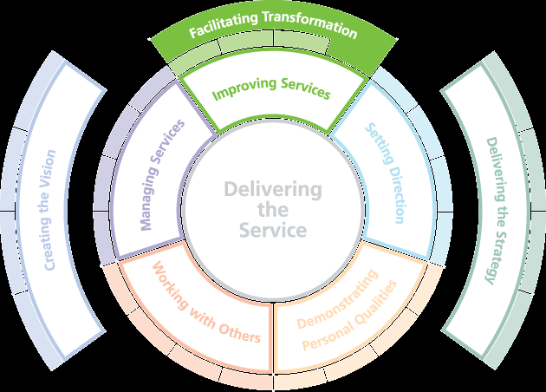

Slide 22
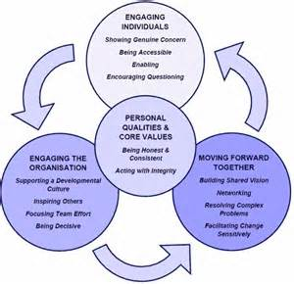

Slide 23
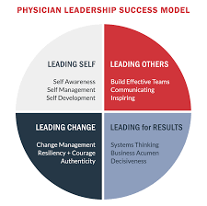

Slide 24
Distributive leadership model:
Conceives leadership as a collective social process emerging through the interactions of multiple actors
Encourages a shift in focus from the attributes and behaviours of individual ‘leaders’ to a more systemic perspective
The leader has a vision, “makes sense” of it, creates change and “relates” (builds supportive networks to achieve the change)
Is collaborative in nature

Slide 25
Distributive leadership model:

Slide 26
Transformational leadership:
Is a leadership approach that causes change in individuals and social systems
Was developed by James MacGregor Burns (1978) to create and sustain change in followers with the goal of developing followers into leaders
The leader identifies the needed change, creates a vision to guide the change through inspiration, and executes the change with the commitment of the members of the group

Slide 27
The leader transforms followers by:
Encouraging them to explore new ways of doing things (intellectual stimulation)
Offering support and encouragement to individual followers (individual consideration)
inspiring them to experience the same passion and motivation to achieve the vision (inspirational motivation)
Serving as a role model for followers (idealized influence)

Slide 28
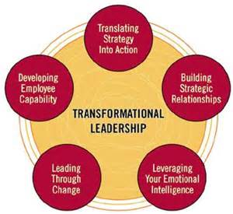
Transformational leadership

Slide 29
Servant-leadership model:
Said to be the most effective model of leadership in healthcare and what the healthcare industry needs to effectively lead change in today’s challenging times (Trastek et al, 2014; Shalaby, 2015)
Involves a service orientation where leaders primarily seek the well-being of their followers
First defined by Robert K. Greenleaf in 1977.

Slide 30
Servant-leaders are described as those who achieve results for their organizations by attending to the needs of those they serve
A nurse servant-leader looks to the needs of his/her staff and continually asks how she can help them solve problems and promote their personal development, while coaching them in their professional practice

Slide 31
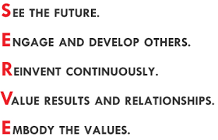
SERVANT-LEADERSHIP

Slide 32
NURSES AND MIDWIVES AS AGENTS OF CHANGE
A well performing nursing workforce is one that works in ways that are responsive, safe and efficient to achieve best possible outcomes
This implies that such a nursing workforce should be ready (in aptitude, attitude and competency) to initiate and implement necessary change in their practice and in patient care.
Change is the only constant thing in life and in today’s healthcare landscape, change is a daily if not an hourly reality
As frontline service professionals, nurses and midwives are critical agents of change in health care delivery

Slide 33
Nurses and midwives are critically positioned to create innovative solutions and change that make a difference in the life and wellbeing of patients, and families because:
They work in a variety of settings with all types of patients, families, communities
Nursing is the glue that holds the system together, (although an invisible glue for so long in Nigeria)
Of their numerical strength (210,306 nurses in Nigeria)

Slide 34
They are also critically positioned because:
Of their unique understanding of and interaction with the patient
They stay most with the patient (24/7 in shift) and so should know more about the patient
To be able to lead change the nurse/midwife must:
Have a clear vision of the issue for change
Be creative and innovation-conscious

Slide 35
Be guided by the latest research and evidence-based practice
Set clear expectations and roles,
Have appropriate knowledge, skills and capabilities to embrace changing technology in health care
Redefine nursing image through a change in attitude and aptitude
Have a positive attitude to change

Slide 36
For a long time nurses and midwives, especially in Europe, America and Australia have been agents of change and innovation in healthcare
Florence Nightingale is credited with developing a form of Pie chart known as “polar-area diagram” or “Nightingale rose diagram”

Slide 37
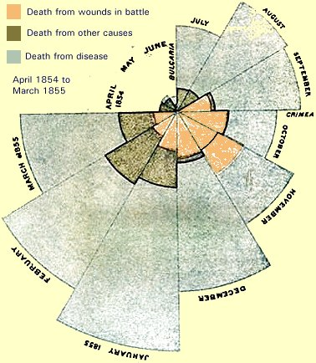

Slide 38
Other areas of nurse-led change in healthcare include:
Transforming care at the bedside (initiated by the American Organization of Nurse Executives in partnership with Robert Wood Johnson Foundation)
A group of nurses at the University of Pennsylvania (Penn nurse scientists) developed:
A Health Technology innovation incubator which won an award
Neonur (a feeding device) designed to reduce failure-to-thrive in newborns

Slide 39
An intensive care nurse in UK won an award for a tracking technology (for infection control) which transforms hand washing compliance using real time tracking technology
Use of mobile phone to track and monitor patients
Nurse-led diabetes care with profound positive results on patients’ glycaemic control in the Netherlands
Midwife-led practice –in many countries
Use of theoretical models and Standardized nursing languages
Nurse-developed Wound care materials (a nurse in UCTH Calabar has developed an innovative healing and skin restoration ointment)

Slide 40
CHALLENGES FOR NURSES AND MIDWIVES AS AGENTS OF CHANGE
To be effective, CHANGE should:
Be affordable
Not compound existing workplace problems
Recognize and reinforce existing strengths
Recognize rectify and/or bolster resource deficits
Be acceptable to stakeholders
Be sustainable

Slide 41
Certain factors may constrain nurses and midwives from being effective change agents in healthcare:
Lack of funds and resources,
Resistance to change,
Outright skepticism and rejection
Depleted and overworked workforce resulting in unwillingness to take on anything that would increase the workload
Lack of confidence in making and managing the change

Slide 42
To overcome these challenges:
Do a cost-risk-benefit analysis
Do a systems assessment to see if:
Individuals and the system are ready for the proposed change
If the ingredients for success are in place
If there is organizational support and commitment to the proposed change
If the MOH, N&MCN, NANNM and other stakeholders support the proposed change

Slide 43
NANNM, MOH, N&MCN and other stakeholders have vital roles to play if nurses and midwives are to be effective leaders and change agents
N&MCN should:
Include in the nurse and midwife training curricula courses in leadership development which should be tailored to students' professional needs
Advocate for the IOM blueprint for the future of nursing leadership to be adapted for cultural relevance and adopted as a guide for nursing practice and leadership in Nigeria

Slide 44
NANNM should :
Drive and support innovative approaches and change culture in the workplace
Provide the forum for discussion and dissemination of important innovations for change
Advocate for inclusion of Nigeria in the Leadership for Change (LFC) programme of ICN

Slide 45
CONCLUSION
Leadership and change are critical issues that the nurse and midwife in Nigeria should embrace with zeal
The time has come for us to demand and take our rightful leadership position in healthcare by acquiring the aptitude and attitude to lead change
As leaders we should resolve to be positively different in providing value-based and quality care
Only then would we (nurses and midwives) be relevant in the healthcare system, and serve as leaders with a vision for change
Let’s keep the flag flying!!!

Slide 47
REFERENCES
Burns, J. M. (1978) Leadership. New York: Harper & Row.
Greenleaf, R. K. (1977) Servant Leadership: A Journey Into the Nature of Legitimate Power and Greatness. New Jersey: Paulist Press.
Shalaby, M. E. (2015) Servant Leadership for Healthcare Organizations. Retrieved on 09-12-15 from https://www.linkedin.com/.../servant-leadership-healthcare-organizations
Trastek, V., Hamilton, N., & Niles, E. (2014). Leadership models in health care - a case for servant leadership. Mayo Clinic Proceedings, 89(3): 374-381.

