Slide 1
KEYNOTE ADDRESS PRESENTED BY PROFESSOR MILDRED E. JOHN, DEPARTMENT OF NURSING SCIENCE, UNIVERSITY OF CALABAR, CALABAR DURING NURSES’ WEEK/MIDWIVES’ DAY CELEBRATION, MAY 2019

Slide 3
Outline
Introduction
Health for All
Nurses, a voice to lead in achieving ‘Health for All’
Why?
How?
The Challenges and way forward
Conclusion

Slide 4
introduction
Good health and wellbeing are the overriding health rights of people globally, and is summed up by SDG 3 as ‘Ensure healthy lives and promote wellbeing for all at all ages’
To achieve this, the Health Care Delivery System is designed to meet the diverse health care needs and expectations of target populations by providing needed services which may be promotive, preventive, curative , or rehabilitative according to need

Slide 5
Health system operators must therefore ensure that essential health services are available, accessible, affordable, and of adequate quality despite constantly changing systems and care protocols
The slogan ‘Health for All’ (HFA) originated at the 30th World Health Assembly in May 1977. In 1981, the Assembly unanimously adopted a Global Strategy of ‘Health for All by the Year 2000’ for people to attain “a level of health that will permit them to lead a socially and economically productive life”

Slide 6
Since then ‘Health for All’ has been WHO’s global health strategy and guiding vision with member countries developing their own strategies for achieving the mandate
However, despite implementation of this strategy for several decades, many developing nations did not achieve its goals and targets
Nigeria for instance is ranked 187th out of 191 countries in WHO’s ranking of the world’s health systems; and after 58 years of independence only a small proportion (<10% coverage) of people actually have access to quality essential health services without facing financial difficulty

Slide 7
Due to non-achievement of the HFA goals, WHO renewed its call on this mandate with focus on ‘Universal Health Coverage’ (UHC) as the drive towards achieving the Sustainable Development Goals (SDGs) and Health for All
So in 2018 the WHO marked its 70th anniversary with the theme “Universal Health Coverage: Everyone, Everywhere” and the slogan “Health for All”

Slide 8
During the event, world leaders were called to commit to concrete steps for advancing health for all, so that everyone, everywhere can access essential quality health services, as a means of ensuring health for all
All the health-related agencies are keying into this with related yearly themes

Slide 9
This keynote address will discuss this theme and try to set an underlying tone for the conference, and stimulate discussion among participants about how nurses can use their collective voice to achieve HFA
The ICN theme for this year’s Nurses’ week celebration is
ICN theme for this year’s Nurses’ week celebration is

Slide 10
Health for all
HFA is based on the principle that all people should be able to “realize their right to basic health services, and attain a level of health that would permit them to lead a socially and economically productive life”
www.cdc.gov

Slide 11
As a signatory to the Alma Ata Declaration of 1978, Nigeria owes her citizens the right to access quality and affordable essential health care no matter their location
Access to healthcare should
not depend on who or where you are
Implies that

Slide 12
Health for All:
Affirms health equity; and access to basic health services for everyone as a fundamental human right
Envisions securing the health and well being of people by removing obstacles to health and bringing health within reach of everybody
Implies that resources for health are evenly distributed and accessible to everyone, with progressive expansion of coverage as more resources become available

Slide 13
Other mandates and strategies operate hand-in-hand to achieve ‘Health for All’
www.who.org

Slide 14
Achieving HFA is everyone’s responsibility (the nation, health system, health workers, healthcare consumers, stakeholders etc.); and a strong and comprehensive primary healthcare is the cornerstone for achieving ‘Health for All

Slide 15
The Nation has the responsibility of:
Putting in place policies that enhance health coverage
Ensuring effective health delivery
Providing adequate health workforce
Increasing access to quality essential healthcare services at affordable cost
Stakeholders in health (NGOs, CBOs, politicians) have the responsibility to ensure that the healthcare system is fulfilling its goals and mandate

Slide 16
Health care providers have the responsibility of helping to strengthen the health system and providing quality services to make them acceptable to the populace, and reaching out to the underserved and unreached
Healthcare consumers need to be responsible and committed to accessing, utilizing, and engaging with available services

Slide 17
The health system itself needs to ensure the existence of certain factors in order to achieve HFA - accessibility, affordability, quality, and utilization of services
Accessibility of services:
Physical accessibility (coverage) services within acceptable distance and physical reach)
Cultural accessibility (acceptability of services irrespective of cultural beliefs)
Economic accessibility (affordability)

Slide 18
Quality of care: services must be consistent with current professional knowledge and produce desired outcomes; services provided must be safe, equitable, timely, effective, efficient, respectful and responsive to patient’s needs and preferences
Utilization of services (actual coverage – the proportion of people in need of a service who actually receive it). This is affected by the quality and timing of services, attitude of service providers etc.
↑ access + ↑ quality + ↓ cost  ↑ utilization, and ensure HFA

Slide 19
Nurses and midwives have roles and responsibilities in:
Enhancing accessibility (ensuring equity in access)
Ensuring acceptability and utilization of services through service outreach, favourable professional attitude, positive professional image
Providing safe, effective, high quality, value-added services through healthcare transformation, and best practices
Advocating for everyone’s right to health

Slide 20
Educating and motivating people to develop and maintain positive health habits (healthy eating, routine exercise, etc.)
Encouraging utilization of promotive and preventive health services to maintain health and limit out-of-pocket expenditure on curative health care
Encouraging the populace to be involved in the National health Insurance Scheme to enhance access to essential health services at affordable cost
Enhancing patient and family engagement in health care

Slide 21
Through the above, nurses and midwives in Nigeria can contribute to the overall health and wellbeing of the society, improve health outcomes, reduce risks to health, and contribute towards the achievement of SDGs, Universal Health Coverage, and ultimately ‘Health for All’

Slide 22
Nurses: a voice to lead in ensuring health for all
According to Judith Shamian, Past ICN President, “Never has there been a time when the ‘voice’ of nurses is more urgently needed at high levels of policy formulation and healthcare decision-making than now”
‘Nurses: a voice to lead…’ is not only for a privileged few but for everyone. Every voice in nursing matters
Every nurse, no matter the level, has a voice and can use that voice to enhance access, utilization and engagement in health care

Slide 23
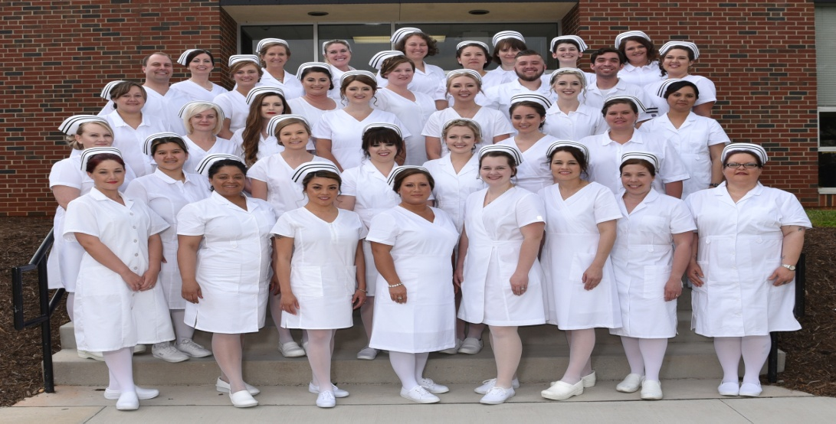
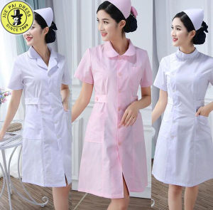
The “nursing voice” is the voice of over 20 million nurses globally who contribute to the health and wellbeing of society

Slide 24
Nurses are a veritable voice to lead in the achievement of health mandates, and so for three years running, the International Council of Nurses has made its theme for the international Nurses’ Week celebration to include ‘Nurses, a voice to lead…’

Slide 25
2019
2018

Slide 26
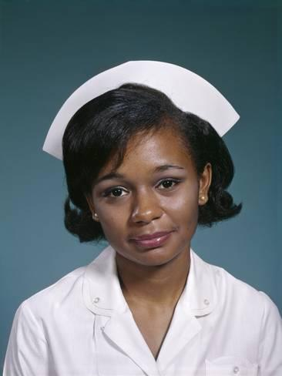
Why is the ‘voice’ of nurses important for achieving ‘Health for All’?
HFA is our responsibility (the right thing to do)
Our professional ethics requires us to be advocates for the health of society

Slide 27
Nurses’ fundamental responsibilities are to promote health, prevent illness, restore health, and alleviate suffering
Through their expanded and extended roles, nurses at every level are responsible for promoting and maintaining health, effectively delivering care for the sick, and evaluating care outcomes and effectiveness

Slide 28
Nursing is a nodal profession (focal point), and coordinates activities of other professionals acting within its perimeter
This nodal position gives nurses a broad appreciation of people’s health needs, and the social and environmental factors affecting the health of individuals, families and communities

Slide 29
Nurses are well positioned and equipped to create situations that can make a difference in the health of people. Therefore they can be a veritable ‘voice’ to enforce good health and wellbeing for society

Slide 30
The nature of nursing: a profession that helps people adopt a healthy lifestyle, enables them to cope with their health problems, and also cares for people during illness;
The numerical strength of nurses - nurses constitute the largest group of professional healthcare providers (>70%);
The proximity and length of stay with the patient – nurses provide care, comfort, education, and information 24/7

Slide 31
A nurse leader sums it up so well: “Nurses are one of the most important bodies to the healthcare system. We are the largest body, we are there for 24 hours a day, seven days a week, the whole three hundred and sixty five days for the year. We are there to ensure that comfort, quality nursing care, quality care by everybody on the team is being offered to the individual. We are so important that we ensure that the work of all other team members is knit together by us”

Slide 32
How Nurses Can Be “A Voice to lead” in achieving hfa
Speaking out for the public (advocacy) and knowing what to say and do, and the right time and place to do so
Amplifying the voice of the public (providing a platform for what they are saying to be heard)
Giving the public a voice (empowering them to speak for themselves)

Slide 33
These imply informing, educating, motivating, empowering, engaging people, and supporting them to fulfil their rights to health
Nurses can do these effectively only if they:
Have adequate knowledge of the society and the social determinants of health
Have a result-oriented mindset and favourable attitude towards the people
Have the skills and competencies to deal with the health needs of society
Are credible (nurses’ attitude determines whether they can be trusted as a ‘voice’)

Slide 34
Achievement of HFA also involves:
Providing appropriate and effective 'downstream' direct care
Eliminating barriers to access and utilization of health services
Making health services functional and appealing to consumers
Collaborating with patient/family and empowering them to live healthy lives

Slide 35
Oftentimes actions speak louder than words, so as nurses and midwives we must remake/rebrand the image of nursing and the nurse by improving our attitude and behaviour; providing sensitive, respectful care; re-focusing on the core values of nursing - caring, comfort, compassion, empathy; transforming nursing care based on evidence and best practices; and adding value to practice at every level and in every location

Slide 36
We can also achieve HFA by improving access to marginalized/underserved populations through:
Health outreach services, after-hour care, home-based care, etc. to under-served, marginalized communities and populations
Equitable access in health care through non-discriminatory care
Giving people-centred, integrated services at contact to focus on the entirety of an individual's health needs

Slide 37
CHALLENGES AND WAY FORWARD
Being a voice to lead in achieving HFA has several challenges:
Shortage of nurses and the reluctance of many nurses to serve in rural and remote communities
Nurses’ knowledge and attitude
Lack of involvement of nurse leaders at the policy table
Many communities are remote and difficult to reach – establishment and use of phone communication could overcome geographical obstacles to health. Ghana is doing this

Slide 38
conclusion
Nurses and midwives are expected to enhance the health and well-being of people and populations no matter where they are working, whether it be in clinical practice, working with individuals and families, in the community or industry
All hand must be on deck and all nurses and midwives must be involved in achieving health for all

Slide 39
Now is the time to stand together and speak as one voice, speak loudly, and speak clearly for the health of everyone !!!!!!

Slide 40
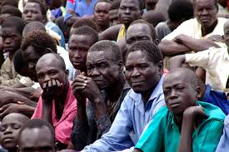
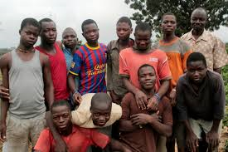
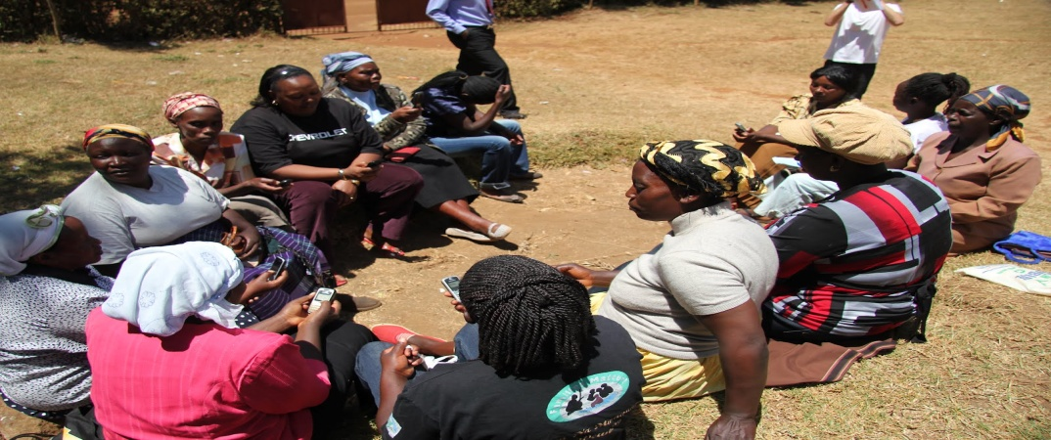
Be A Voice

Slide 41
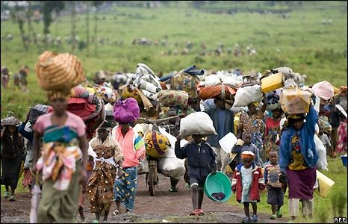
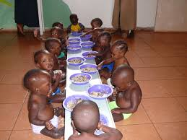
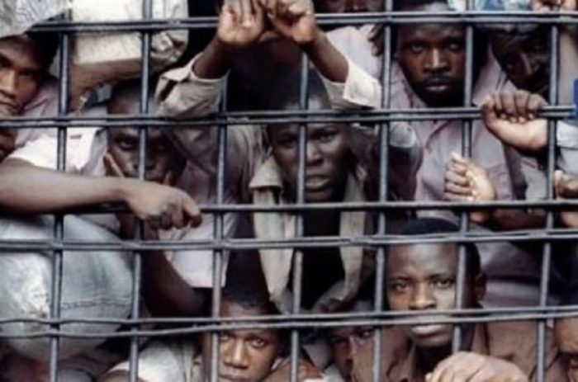
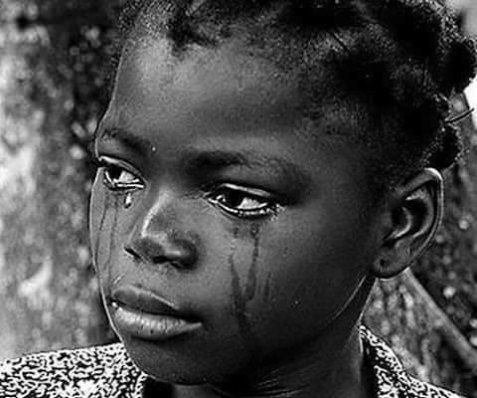
Be a Voice

Slide 42
www.clipart-library.com

